Slide 1
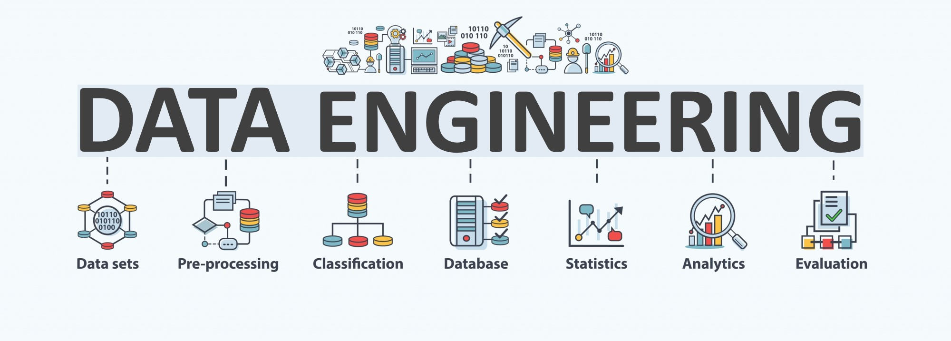

Lecture 1: Introduction & Data Ecosystem
CS5481 Data Engineering
Instructor: Yifan Zhang

Slide 2
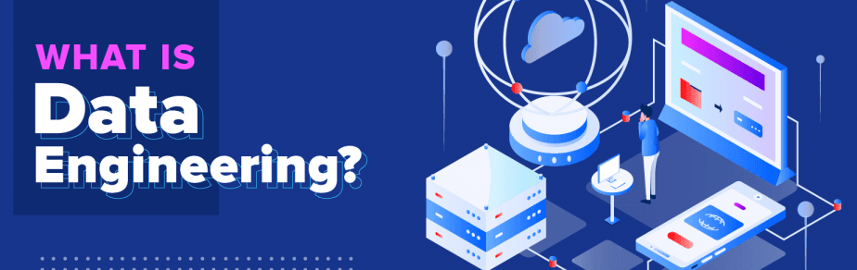
Big data is changing the way we do business and creating a need for data engineers who can collect and manage large quantities of data.
Data engineering is the practice of designing and building systems for collecting, storing, and analyzing data at scale.

Slide 3
Outline
1. Course organization
2. Overview of the data engineering ecosystem
3. Types of data
4. Languages and tools for data professionals

Slide 4
Bird’s-eye view of this course
Data pipeline
Data acquisition, data processing, and data storage
Data management
Data processing techniques for data driven applications
Information retrieval, recommendations, social network analysis, anomaly detection

Slide 5
Instruction pattern
3-hour in-class learning
2-hour lecture, Wednesday, 9:30-11:30, AC5-415
Cover main topics of the course
1-hour tutorial, Wednesday, 8:30-9:20, AC1-201
In-class hands-on ability, discussions, presentations, etc.
After class
Homework assignments and projects
Reading recent advances of related fields, implementation details,
Papers, technical blogs, GitHub, etc.
QA
Canvas -> discussions is most preferred
Email for more personalized questions
TAs for hands-on issues

Slide 6
Teaching team
Dr. Yifan Zhang
Yeung AC4 502, yifan.zhang@cityu-dg.edu.cn
TA
Mr. Haoyu Zhang, AC4 533 (haoyu.zhang@cityu-dg.edu.cn)

Slide 7
Assessment
Continuous assessment (60%)
2 individual homework assignments (each 15%)
Answer questions and/or programming to implement simple data engineering tasks
1 group project with presentations (30%)
Form a group of 2-3 students (before Week 5)
Select one topic among several given topics
Do experiments and show your innovation and novelty
Reports + codes + others (datasets, proofs, figures, etc.)
Presentation (Weeks 12)
Final exam (40%)

Slide 8
Schedule
Week | Date | Topic | HW
1 | 01/13/2025 | Introduction (data ecosystem)
2 | 01/15/2025 | Data acquisition | Assign HW1
3 | 01/22/2025 | Data preprocessing
4 | 02/19/2025 | Data visualization
5 | 02/26/2025 | Data indexing | Assign HW2, HW1 due
6 | 03/05/2025 | Data querying | Assign group project
7 | 03/12/2025 | Data driven applications (1)
8 | 03/19/2025 | Data driven applications (2) | HW2 due
9 | 03/26/2025 | Data management
10 | 04/02/2025 | Advanced topics and recent trends
11 | 04/09/2025 | Project presentation | Group project due
12 | 04/16/2025 | Course review
13 | 04/23/2025 | Course review

Slide 9
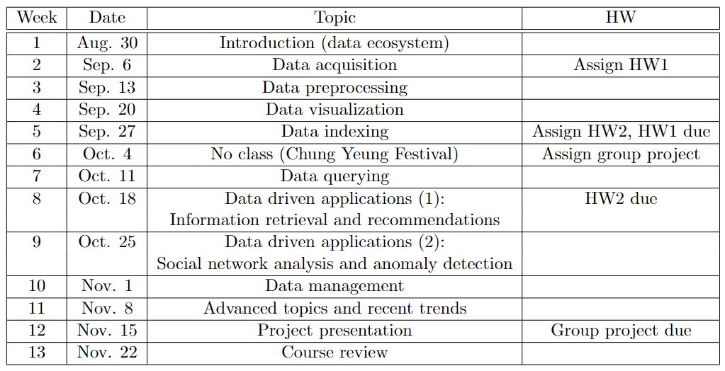
Schedule

Slide 10
Resources
Computing resources
Jupyterhub for tutorials, home assignments and group projects.
Google Colab: https://colab.research.google.com/
Other resources: Kaggle (kaggle.com/notebooks), other online resources, CS Lab AC1 201
Other online courses

Slide 11
How to learn this course well?
Higher-level postgraduate courses
What problems to solve?
How to approach the problem?
Systematic ideas instead of details
This data engineering course
Get your hands dirty, as it is mainly about how to process data and implement systems for domain applications
Follow recent academic and industrial advances
Discuss with others

Slide 12
Outline
1. Course organization
2. Overview of the data engineering ecosystem
3. Types of data
4. Languages and tools for data professionals

Slide 13
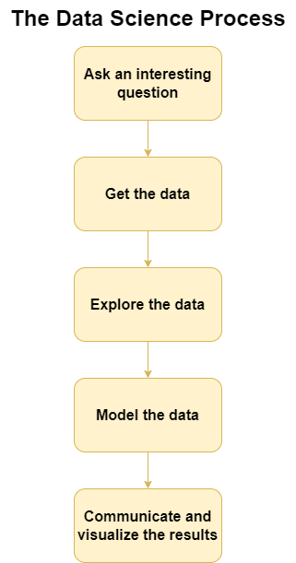
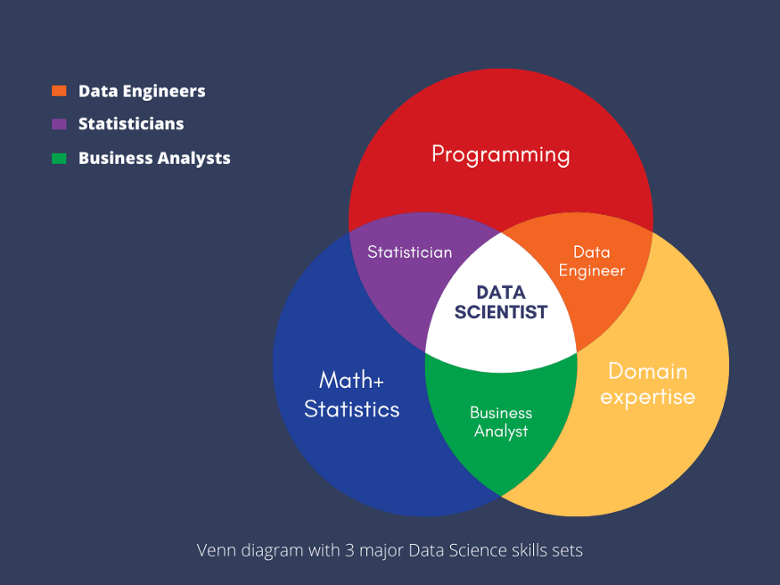
Venn diagram with three dimensional skills for ‘data related work’: coding + maths + domain knowledge
Notes:
https://harvard-iacs.github.io/2018-CS109A/lectures/lecture-2/

Slide 14
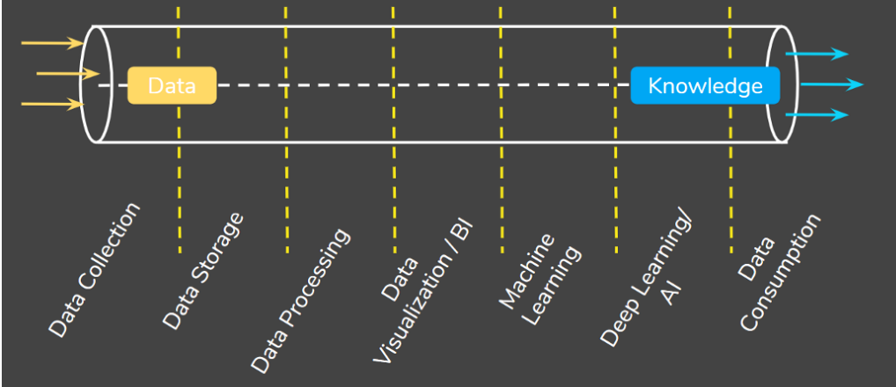
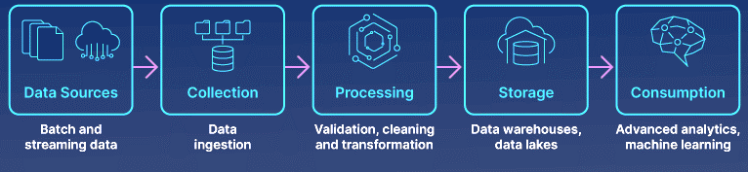
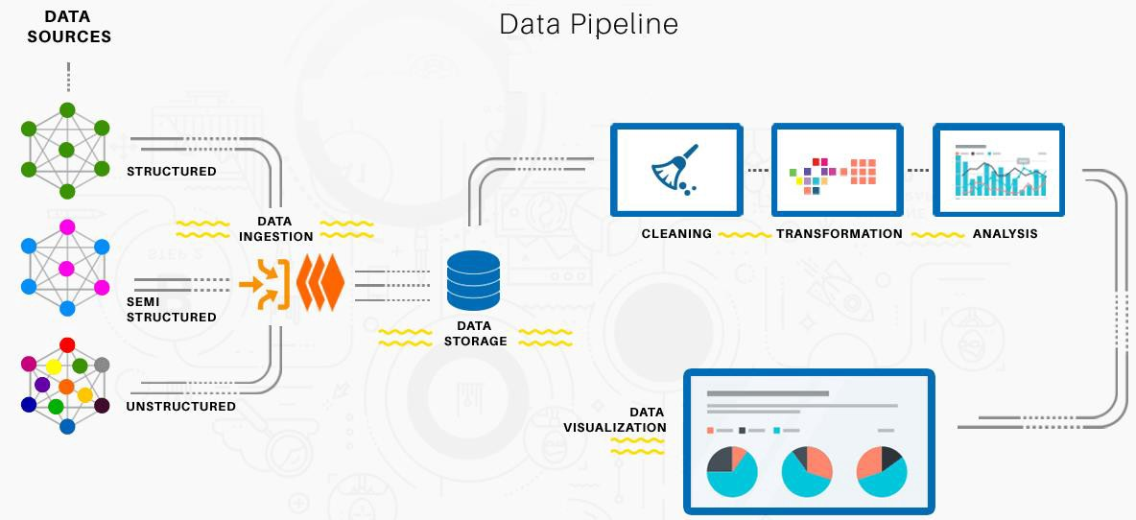
Data engineering pipeline
The Goal of Data Engineering is to provide organized, standard data flow to enable data-driven models such as machine learning models, data analysis.
Notes:
1. https://macxima.medium.com/data-engineering-572733412d54
2. https://www.analyticsvidhya.com/blog/2021/06/data-engineering-concepts-and-importance/

Slide 15
Data engineering ecosystem
A Data Engineer’s ecosystem includes the infrastructure, tools, frameworks, and processes for:
Extracting data from disparate sources
Architecting and managing data pipelines for transformation, integration, and storage of data
Architecting and managing data repositories
Automating and optimizing workflows and flow of data between systems
Developing applications needed through the data engineering flow
It is a diverse, rich , and challenging ecosystem.

Slide 16
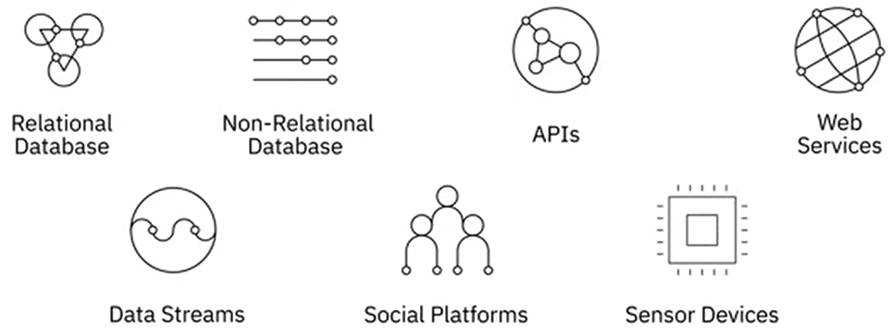
Data engineering ecosystem: data sources
Data comes in a wide-ranging variety of file formats being collected from a variety of data sources:

Slide 17
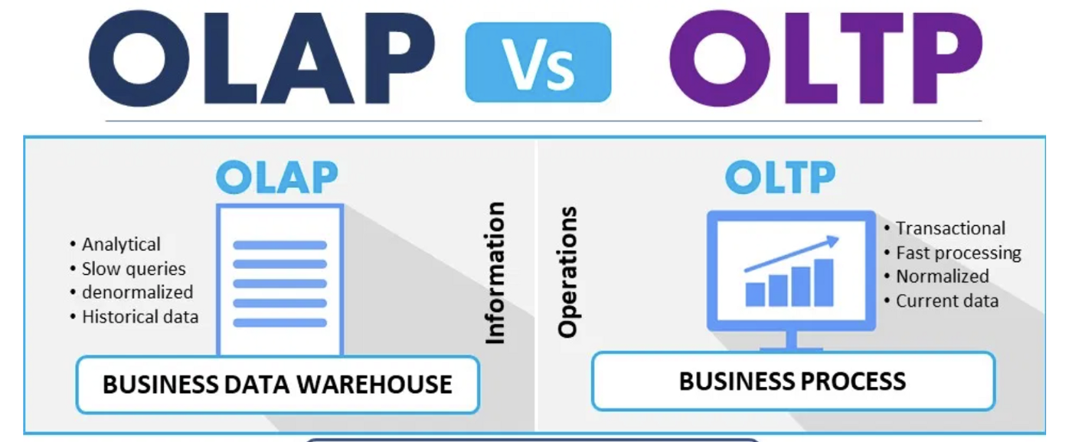
Data engineering ecosystem: data storage
Online Analytical Processing (OLAP) Systems
Online Transaction Processing (OLTP) Systems
Optimized for conducting complex data analytics
Include relational and non-relational databases, data warehouses, data marts, data lakes, and big data stores
Designed to store high volume day-to-day operational data
Typically relational, but can also be non-relational

Slide 18
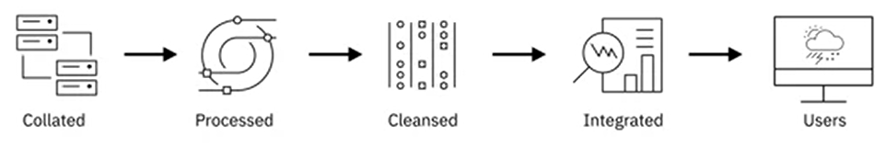
Data engineering ecosystem: data integration
Combine data from disparate sources into a unified view, accessed by users to query and manipulate the data.

Slide 19

Data engineering ecosystem: data analysis
Data analysis is to discover useful information, informing conclusions, and supporting decision-making from data, in different business, science, and social science domains. In today's business world, data analysis plays a role in making decisions more scientific and helping businesses operate more effectively.
It often involves data mining and machine learning techniques to model and process the data.

Slide 20
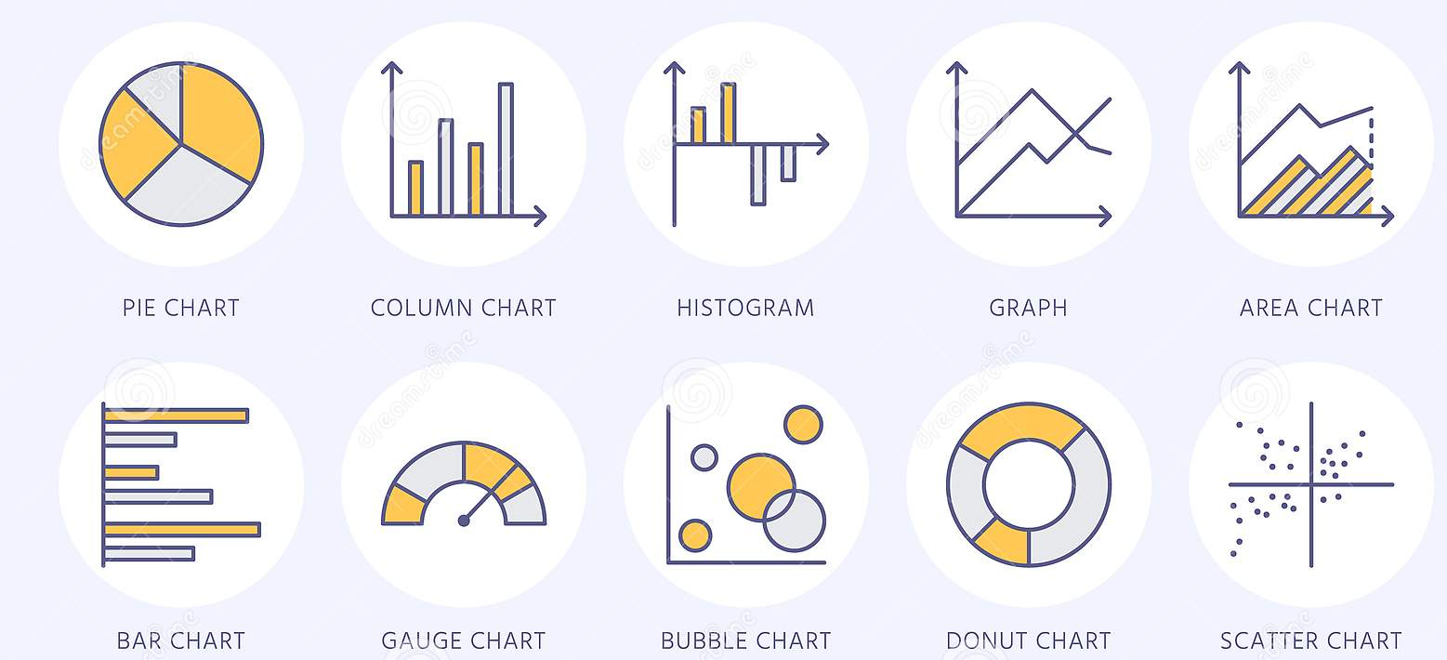
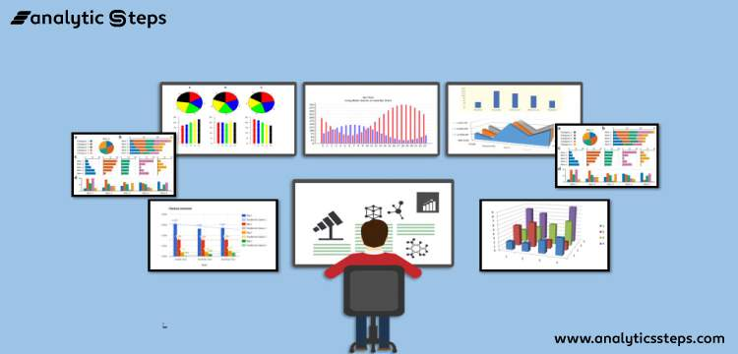
Data engineering ecosystem: data visualization
Business Intelligence (BI) and Reporting Tools
Collect data from multiple data sources and present them in a visual format, such as interactive dashboards.
Visualize data in real-time and predefined schedule.
Drag and drop products that do not require knowledge of programming
Notes:
https://www.dreamstime.com/chart-types-flat-line-icons-linear-graph-column-pie-donut-diagram-financial-report-illustrations-infographic-thin-signs-image125327945

Slide 21
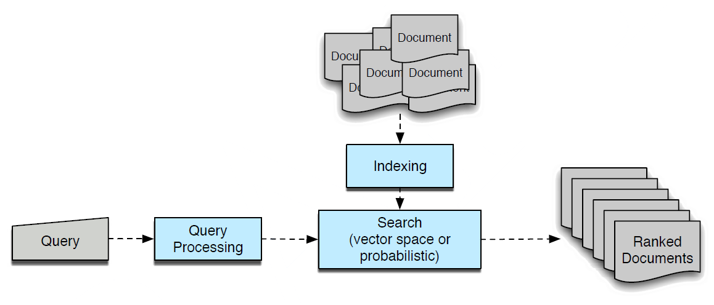
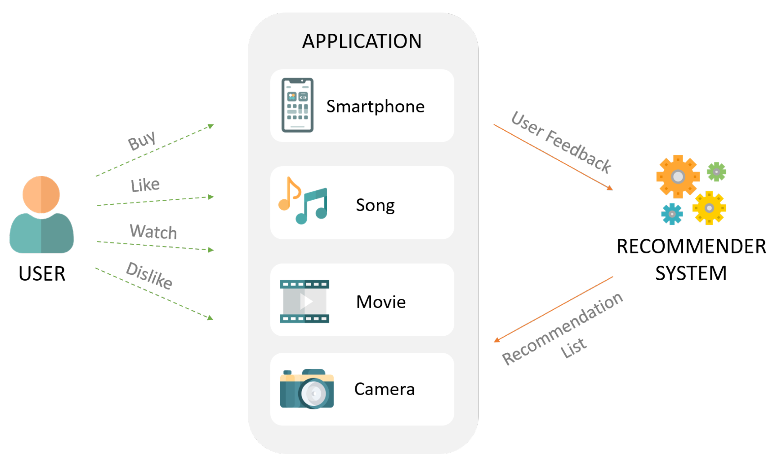
Data engineering ecosystem: data-driven applications (1)
Information retrieval (IR) is the process of obtaining information system resources that are relevant to an information need from a collection of those resources (texts, images or sounds). Searches can be based on full-text or other content-based indexing.
A recommender system is a subclass of information filtering system that seeks to predict the “rating” or “preference” a user would give to an item.
Notes:
https://www.dreamstime.com/chart-types-flat-line-icons-linear-graph-column-pie-donut-diagram-financial-report-illustrations-infographic-thin-signs-image125327945

Slide 22
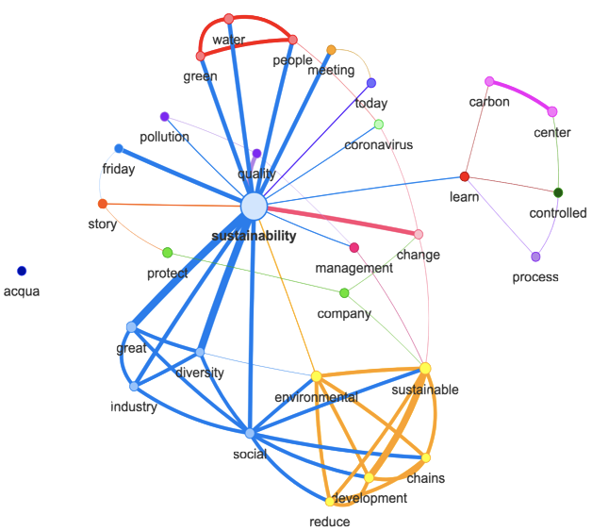
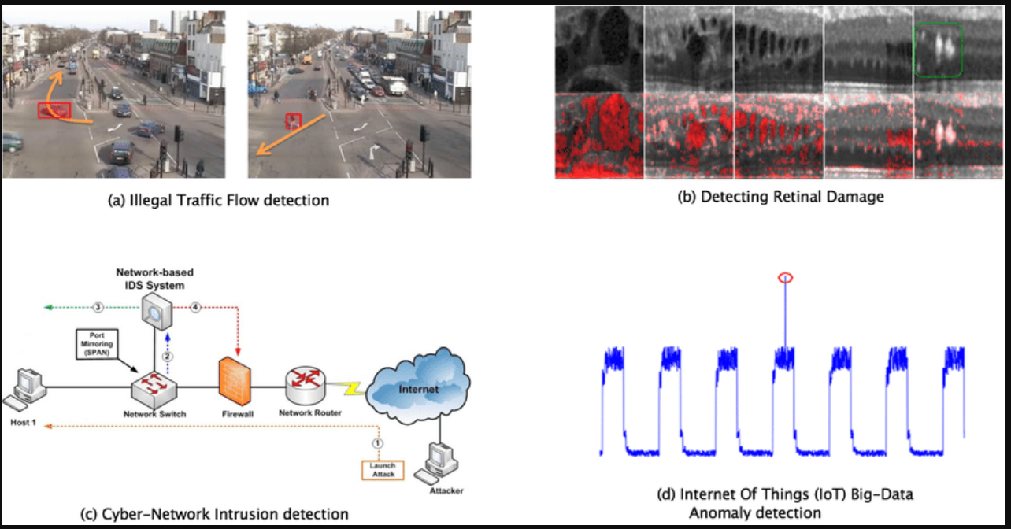
Data engineering ecosystem: data-driven applications (2)
Social network analysis investigates social structures through the use of networks and graph theory. It characterizes networked structures in terms of nodes (individual actors, people, or things within the network) and the ties, edges, or links (relationships or interactions) that connect them.
Anomaly detection is the identification of rare events, items, or observations which are suspicious because they differ significantly from standard behaviors or patterns. Anomalies in data are also called standard deviations, outliers, noise, novelties, and exceptions.
Notes:
https://www.dreamstime.com/chart-types-flat-line-icons-linear-graph-column-pie-donut-diagram-financial-report-illustrations-infographic-thin-signs-image125327945

Slide 23
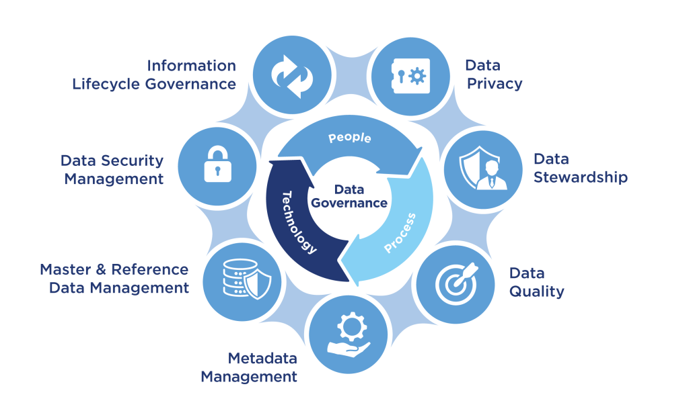
Data engineering ecosystem: data governance
Data quality: how well suited a data set is to serve its specific purpose, such as accuracy, completeness, consistency, validity, uniqueness, biasness, and timeliness.
Data security: safeguarding data throughout its entire life cycle to protect it from corruption, theft, or unauthorized access. It covers everything—hardware, software, storage devices, and user devices; access and administrative controls; and organizations' policies and procedures.
Data privacy: proper handling of sensitive data including personal data and other confidential data, such as certain financial data and intellectual property data, to meet regulatory requirements as well as protecting the confidentiality and immutability of the data.
Notes:
https://www.dreamstime.com/chart-types-flat-line-icons-linear-graph-column-pie-donut-diagram-financial-report-illustrations-infographic-thin-signs-image125327945

Slide 24
Outline
1. Course organization
2. Overview of the data engineering ecosystem
3. Types of data
4. Languages and tools for data professionals

Slide 25
Types of data
Structured
Semi-Structured
Unstructured
Data that follows a rigid format and can be organized into rows and columns.
Mix of data that has consistent characteristics and data that does not conform to a rigid structure
Data that is complex and mostly qualitative information that cannot be structured into rows and columns

Slide 26
Structured data (1)
Has a well defined structures.
Can be stored in well-defined schemas.
Can be represented in a tabular manner with rows and columns.
Structured data is objective facts and numbers that can be collected, exported, stored, and organized in typical databases.

Slide 27
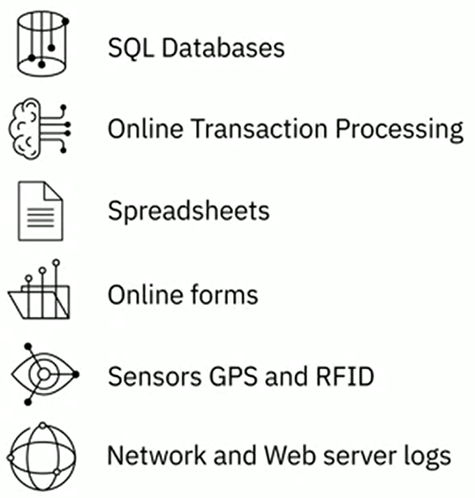
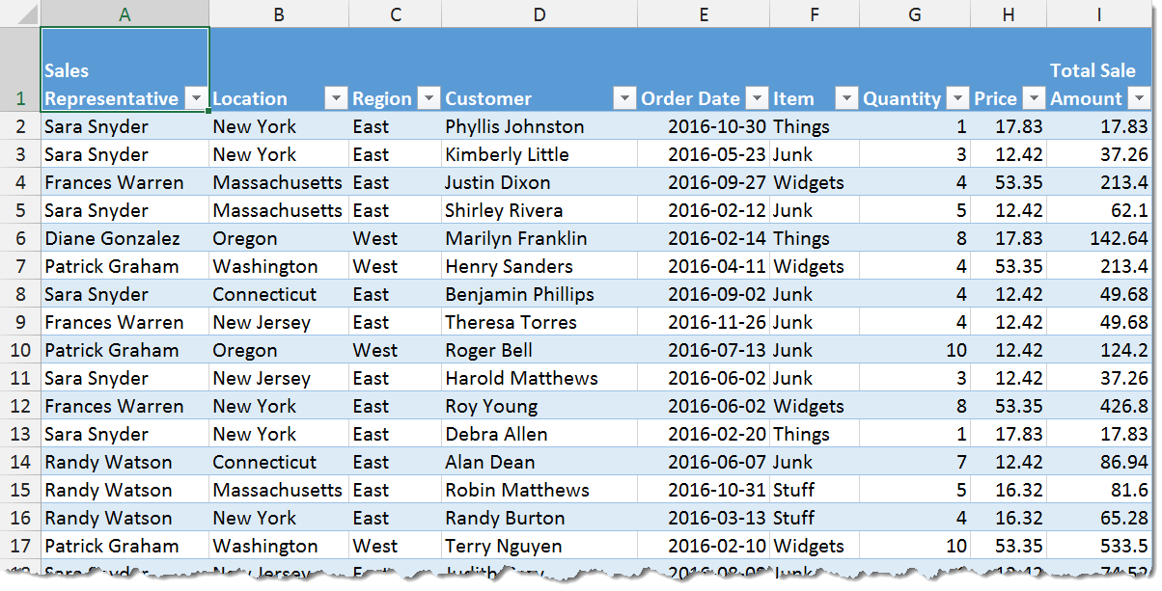
Structured data (2)
Sources of structured data includes:

Slide 28
Semi-structured data (1)
Has some organizational properties but lacks a fixed or rigid schema.
Cannot be stored in the form of rows and columns as in databases.
Contains tags and elements, or metadata, which is used to group data and organize it in a hierarchy.

Slide 29
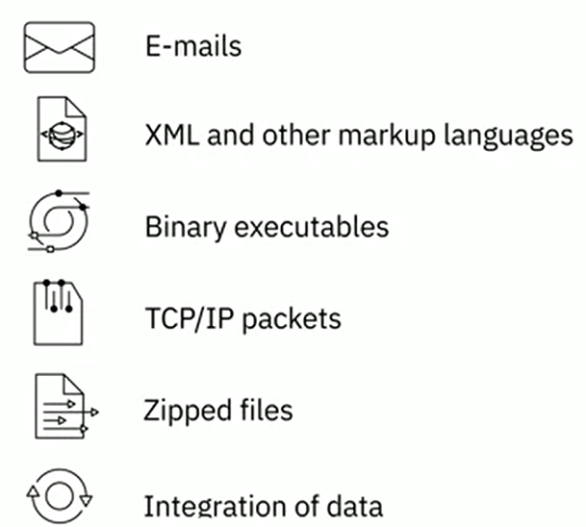
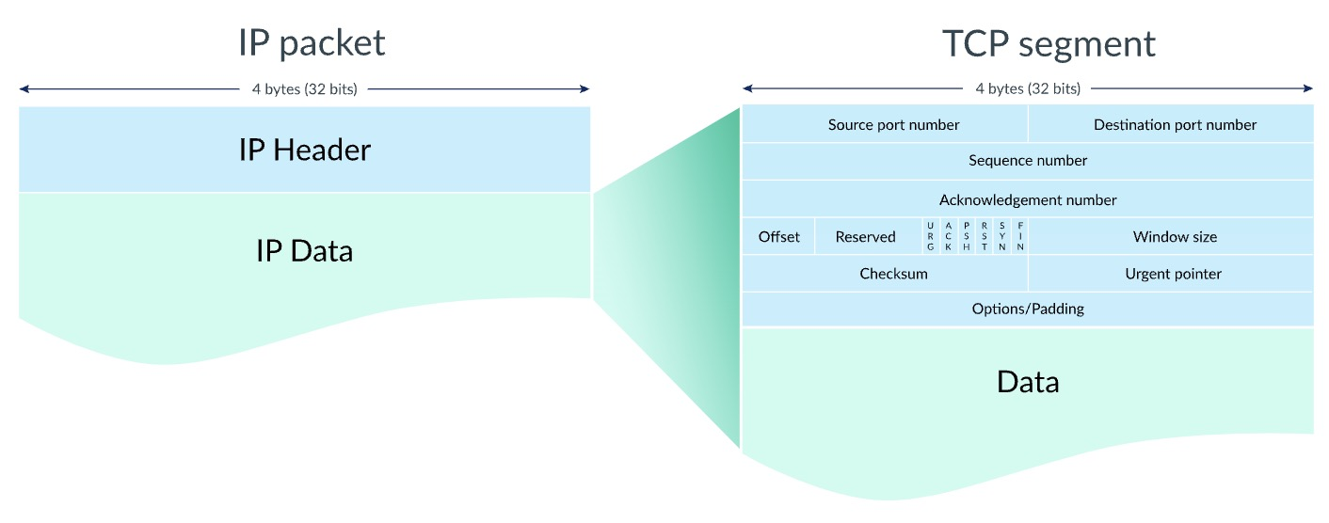
Semi-structured data (2)
Sources of semi-structured data
XML and JSON allow users to define tags and attributes to store data in a hierarchical form and are used widely to store and exchange semi-structured data.

Slide 30
Unstructured data (1)
Does not have an easily identifiable structure.
Cannot be organized in a mainstream relational database in the form of rows and columns.
Does not follow any particular format, sequence semantics, or rules.

Slide 31
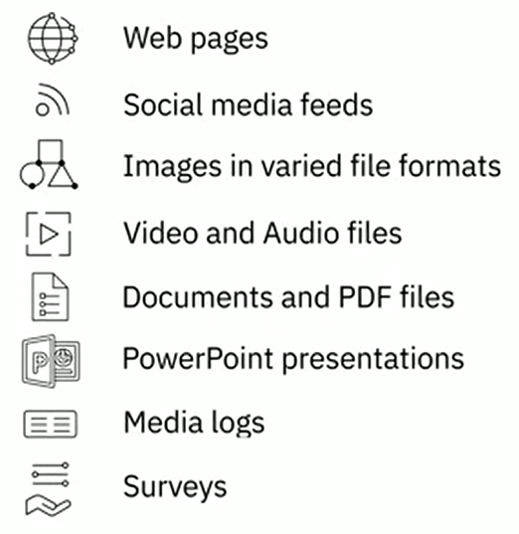
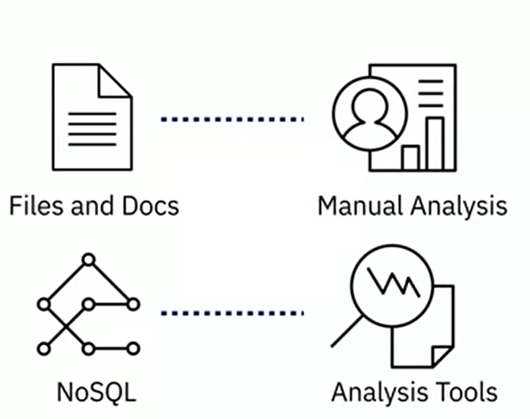

Unstructured data (2)
Sources of unstructured data

Slide 32
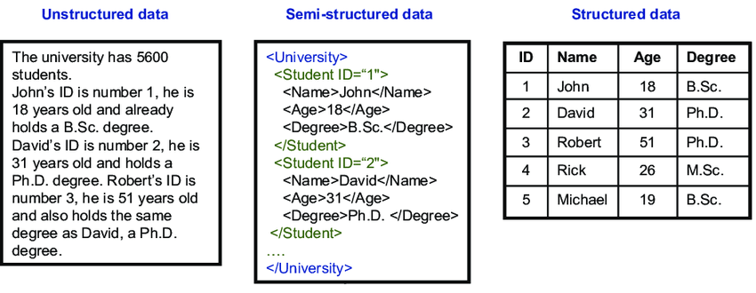
Examples of different types of data

Slide 33
Outline
1. Course organization
2. Overview of the data engineering ecosystem
3. Types of data
4. Languages and tools for data professionals

Slide 34



Languages for data professionals
Query Languages
Programming Languages
Shell and Scripting Languages
For example, SQL for querying and manipulating data
For example, Python for developing data applications
For repetitive and time-consuming operational tasks

Slide 35


Query languages
Advantages of using SQL:
SQL is portable and platform independent.
Can be used for querying data in a wide variety of databases and data repositories.
Has a simple syntax that is similar to the English language
Can retrieve large amount of data quickly and efficiently
Runs on an interpreter system.

Slide 36
General programming languages – Python
Python is one of the fastest-growing programming languages in the world.
Advantages of using Python:
Easy to learn and Open-source
Can be ported to multiple platforms and has widespread community support.
Provides open-source libraries for data manipulation, data visualization, statistics, mathematics.

Slide 37

Statistical programming languages – R
Advantages of using R-programming:
Open-source and platform-independent.
Can be paired with many programming languages and highly extensible.
Facilitates the handling of structured and unstructured data.
Can be used for developing statistical tools.

Slide 38

General programming languages – Java
Java is an object-oriented, class based, and platform-independent programming language.
Advantages of using Java:
One of the top-ranked programming languages used today.
Used in a number of data analytics processes – cleaning data, importing and exporting data, statistical analysis, data visualization.
Used in the development of big data frameworks and tools – Hadoop, Hive, Spark
Well-suited for speed critical projects.

Slide 39
Shell and scripting languages
Typical operation performed by shell scripts include:
File manipulation
Program execution
System administration tasks such as dis backups and evaluating system logs
Installation scripts for complex programs
Executing routine backups
Running batches.

Slide 40
Shell and scripting languages - PowerShell
PowerShell is a cross-platform automation tool and configuration framework by Microsoft that is optimized for working with structured data formats.
Consists of command-line shell and scripting language
Object-based and can be used to filter, sort, measure, group, and compare objects as they pass through a data pipeline.
Used for data mining, building GUIs, creating charts, dashboards, and interactive reports.

Slide 41
Thanks for your attention!

Slide 42
References 1. https://www.coursera.org/learn/introduction-to-data-engineering 2. https://macxima.medium.com/data-engineering-572733412d54 3. https://www.analyticsvidhya.com/blog/2021/06/data-engineering-concepts-and-importance/

